Slide 1
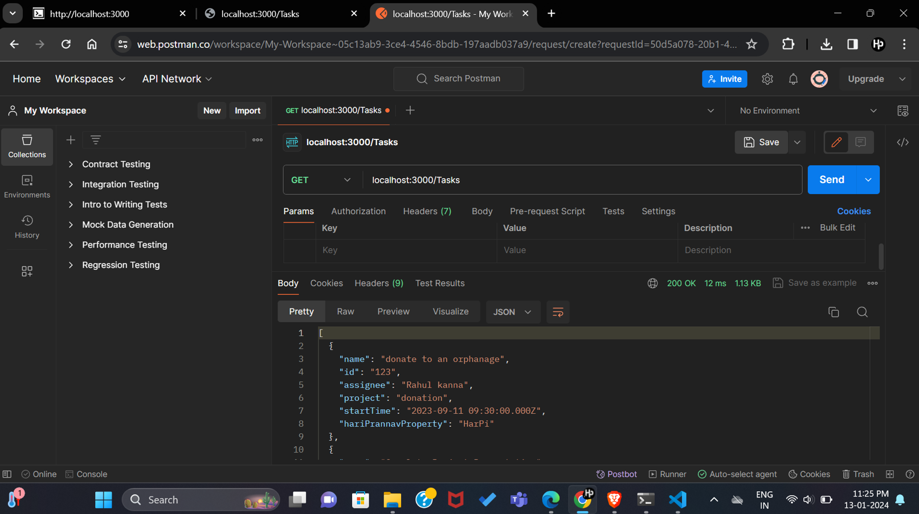
Hariprannav D

Slide 2
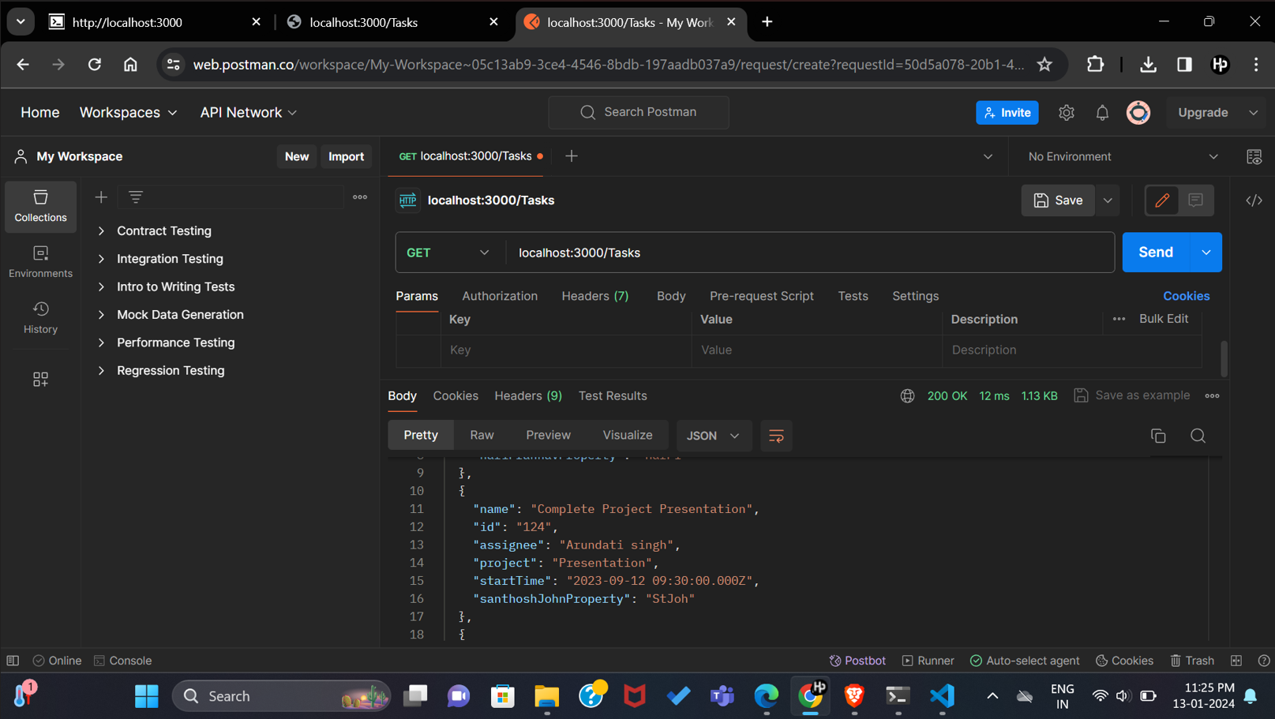
Hariprannav D

Slide 3
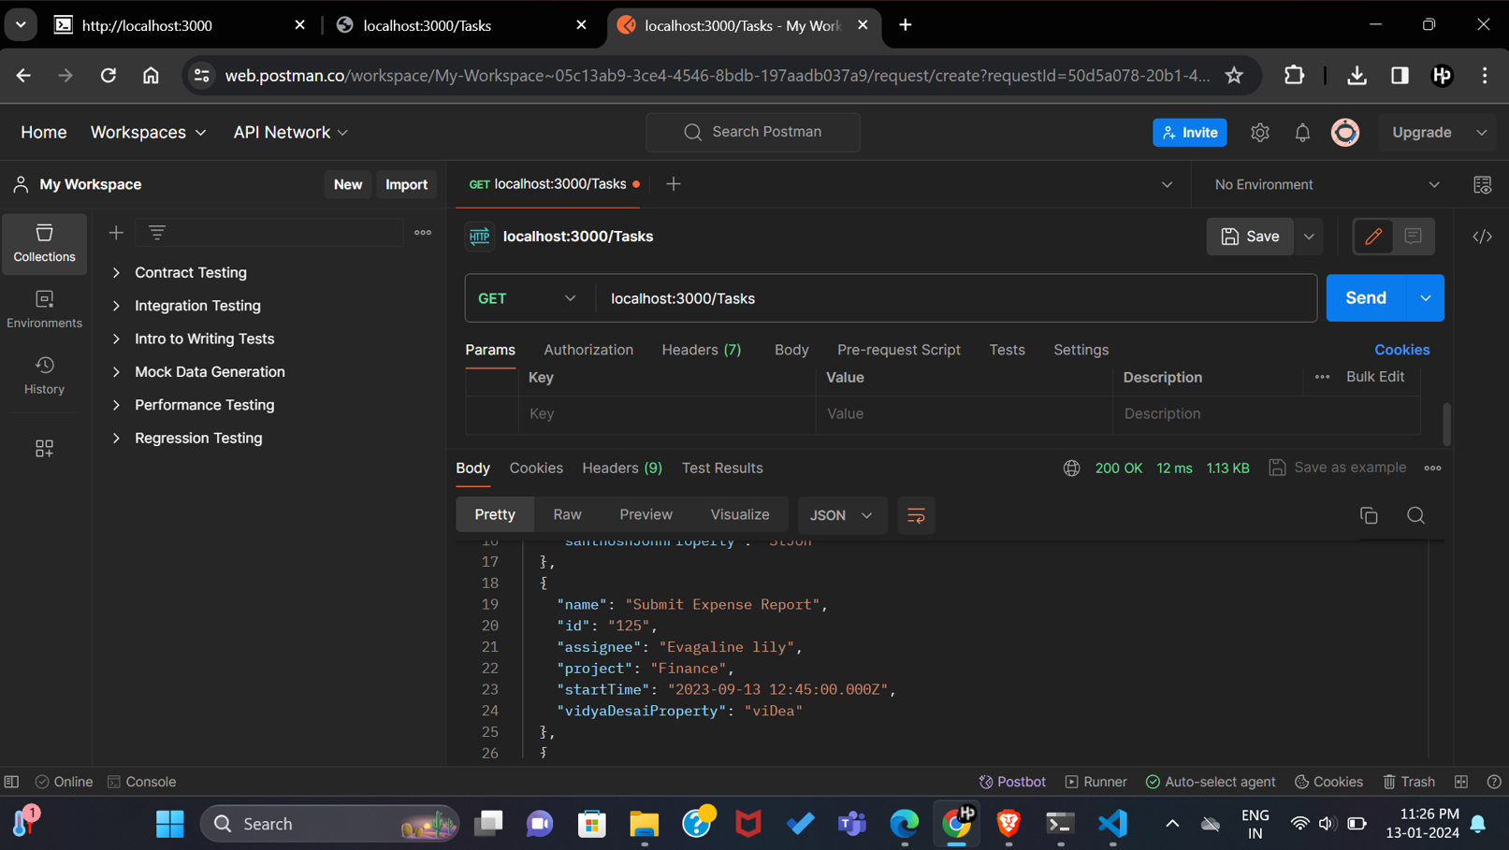
Hariprannav D

Slide 4

Hariprannav D

Slide 5
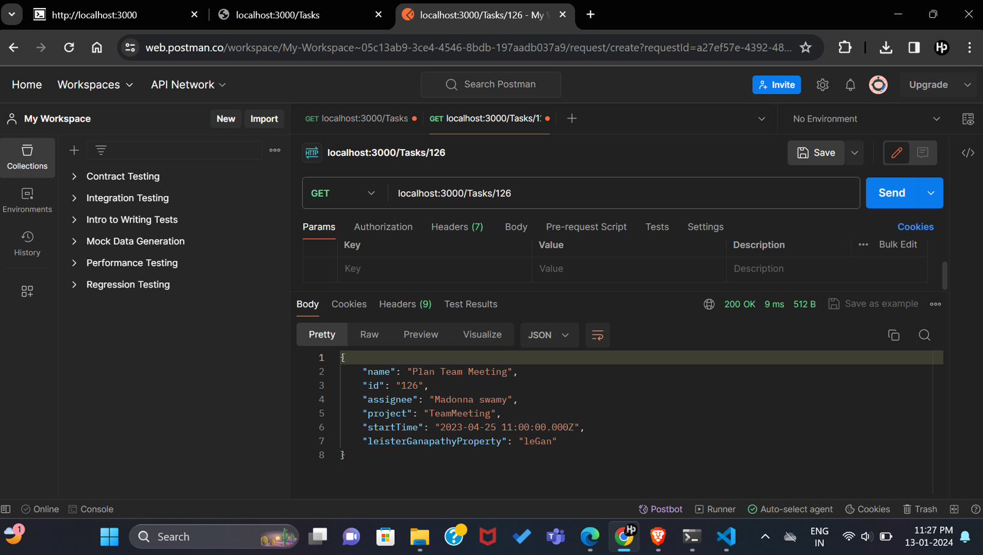
Hariprannav D

Slide 6
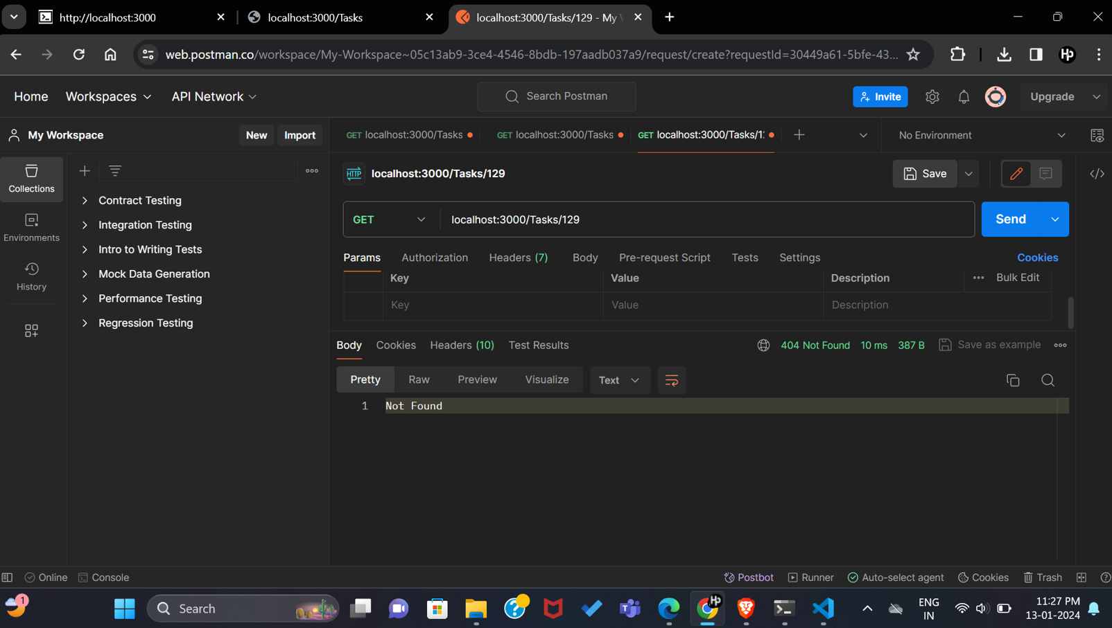
Hariprannav D

Slide 7
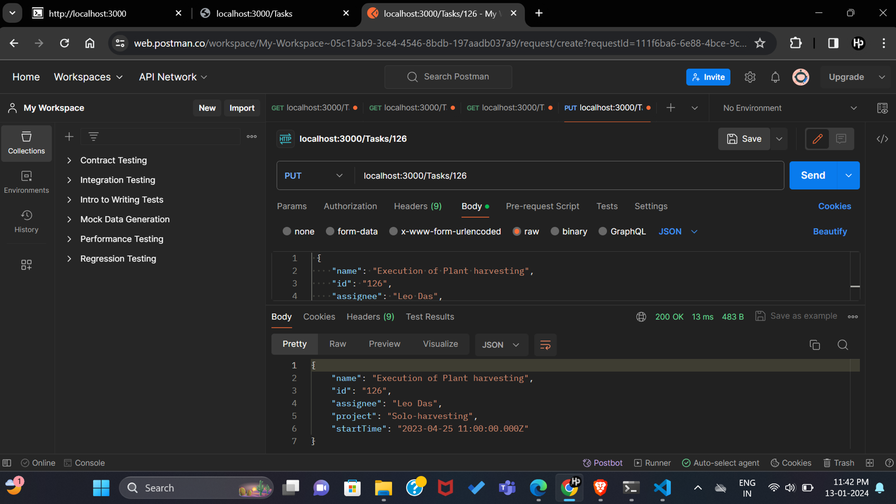
Hariprannav D

Slide 8
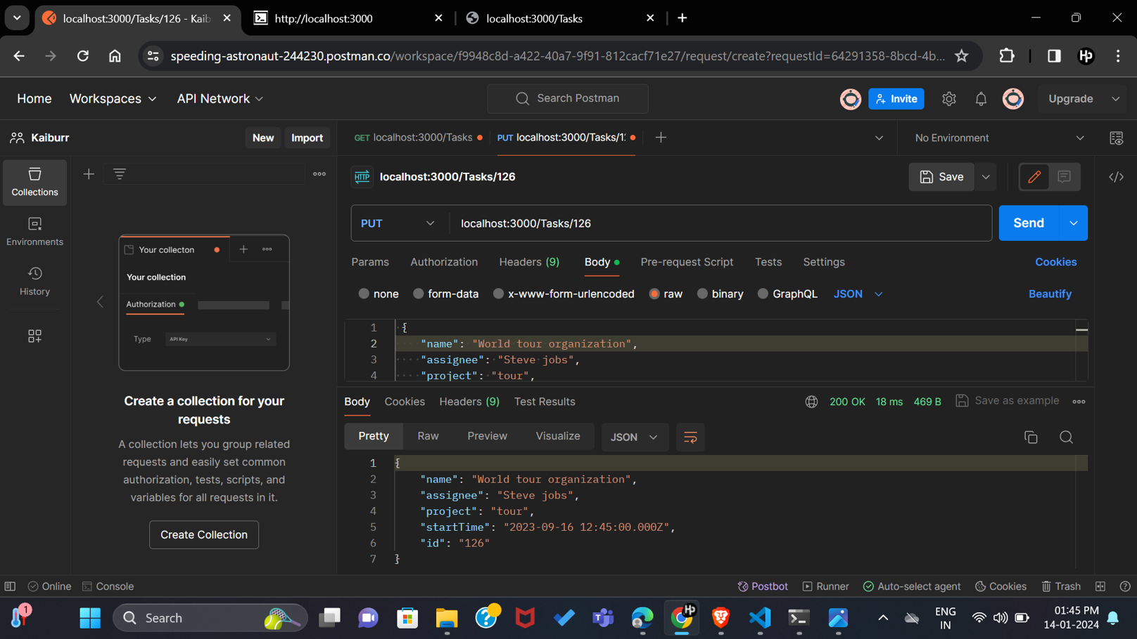
Hariprannav D

Slide 9
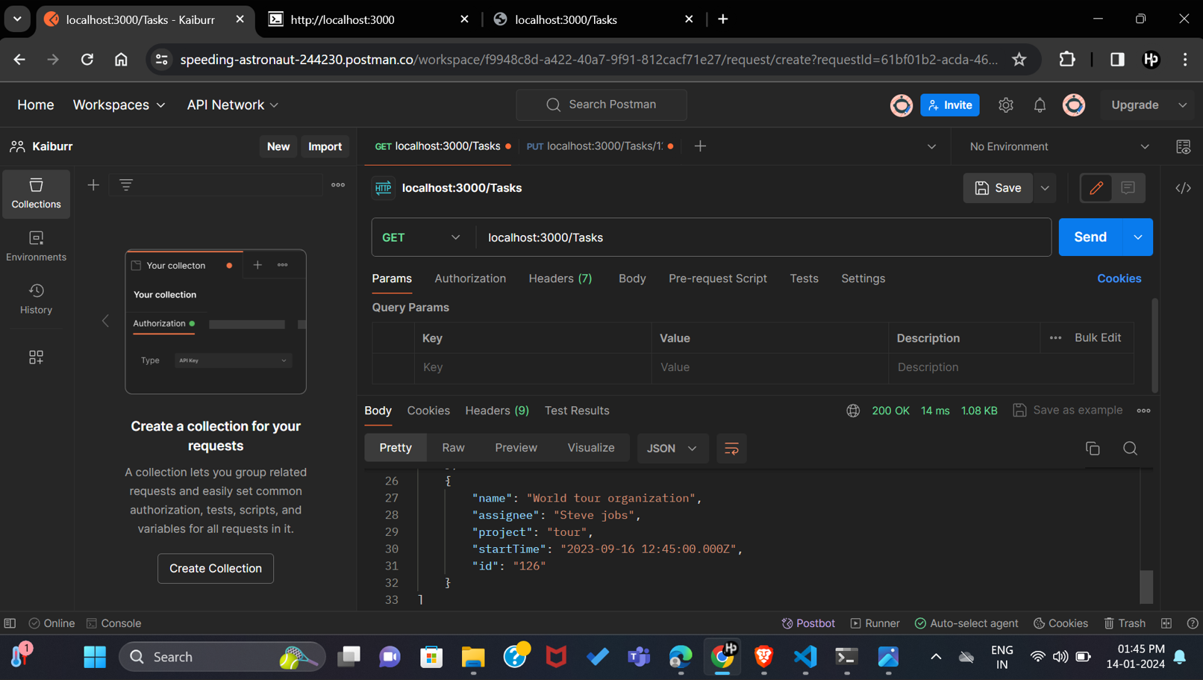
Hariprannav D

Slide 10
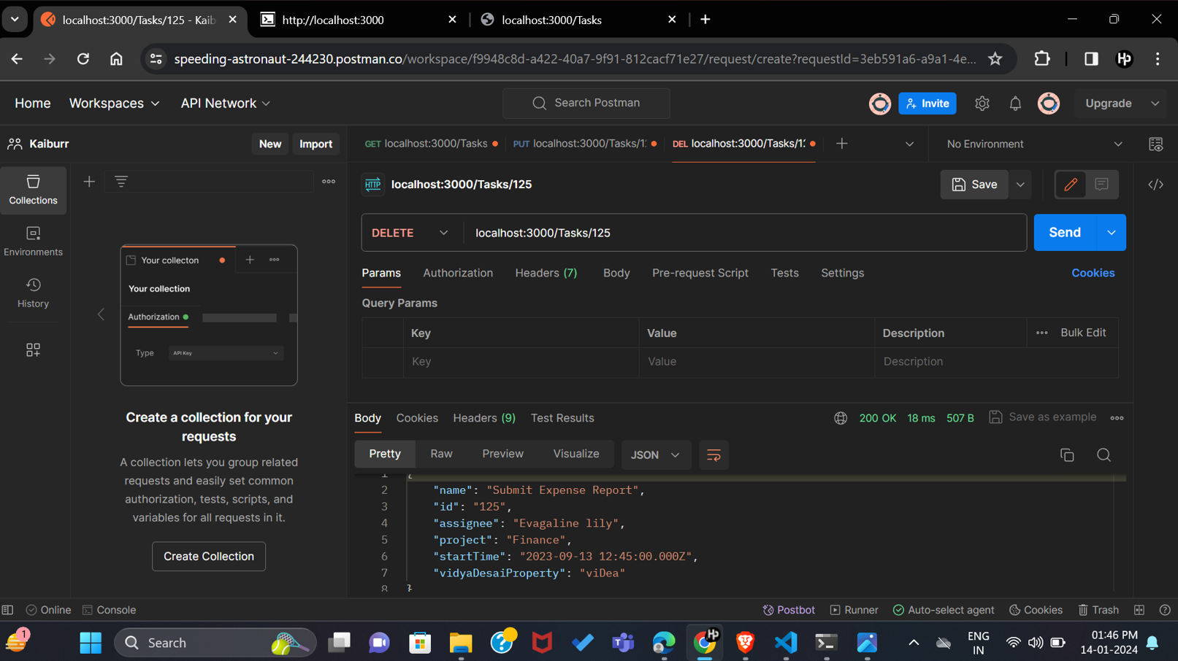
Hariprannav D

Slide 11
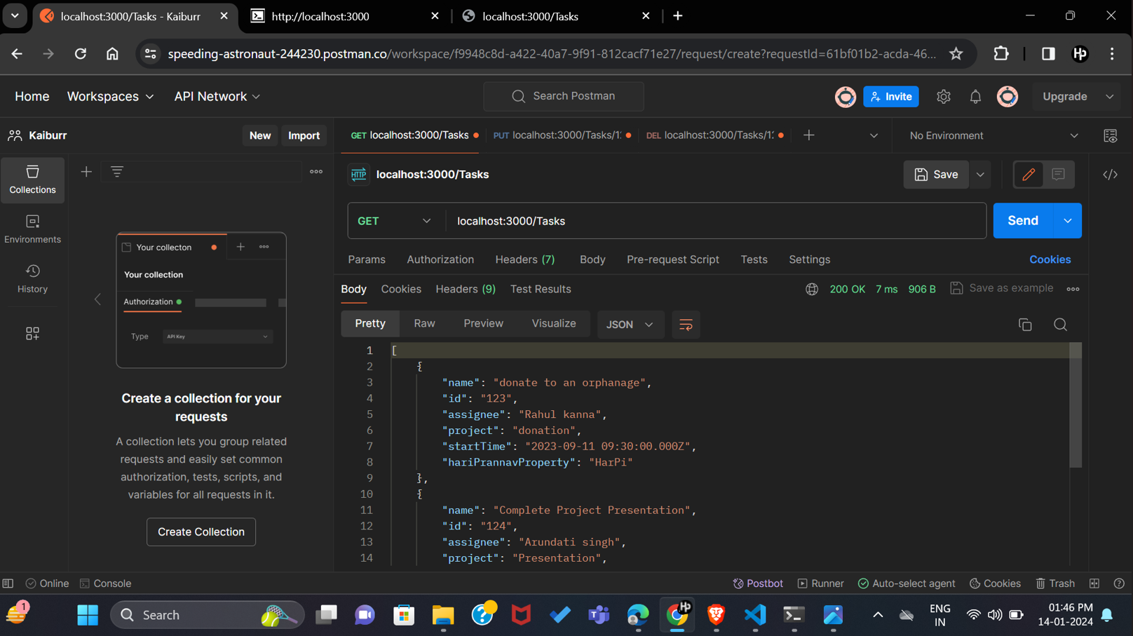
Hariprannav D

Slide 12
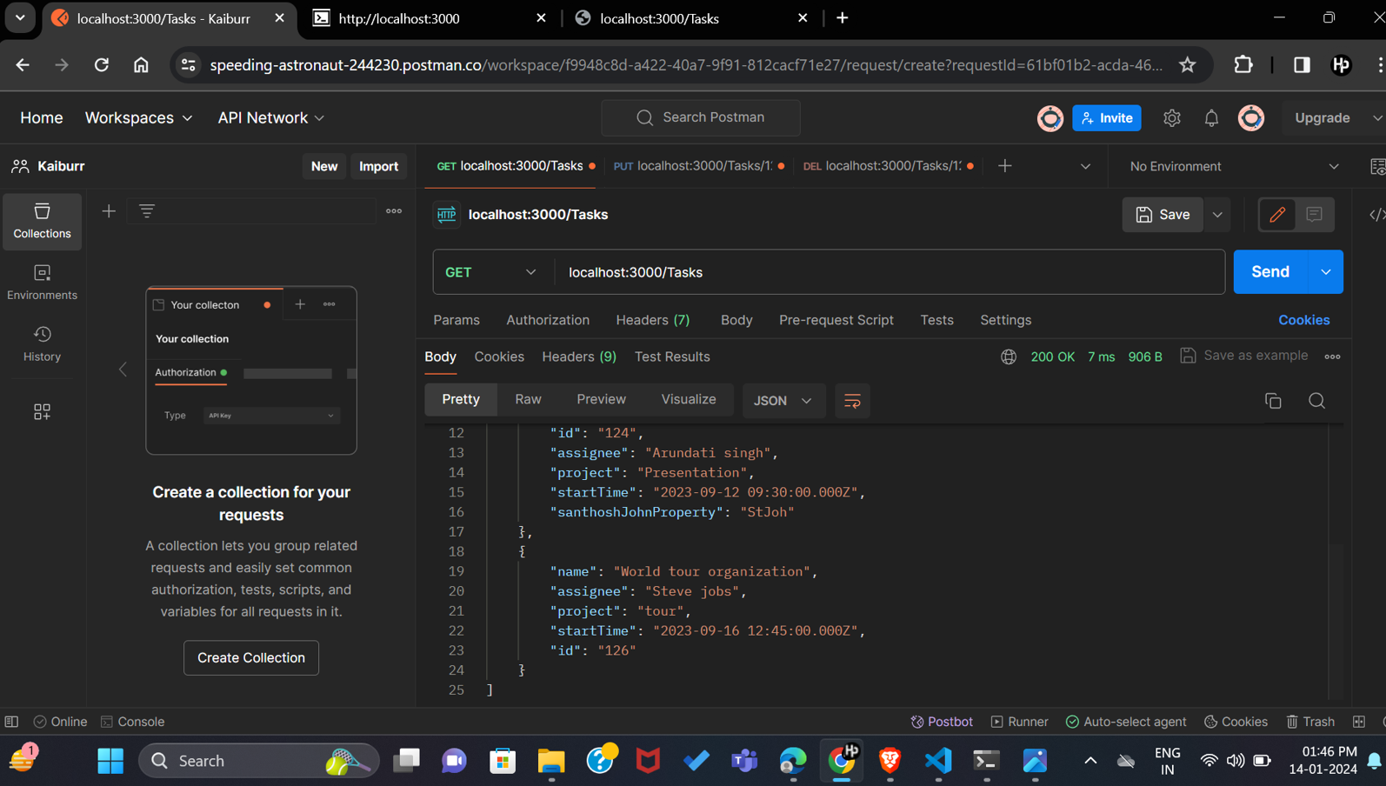
Hariprannav D

Slide 13

Hariprannav D

Slide 14
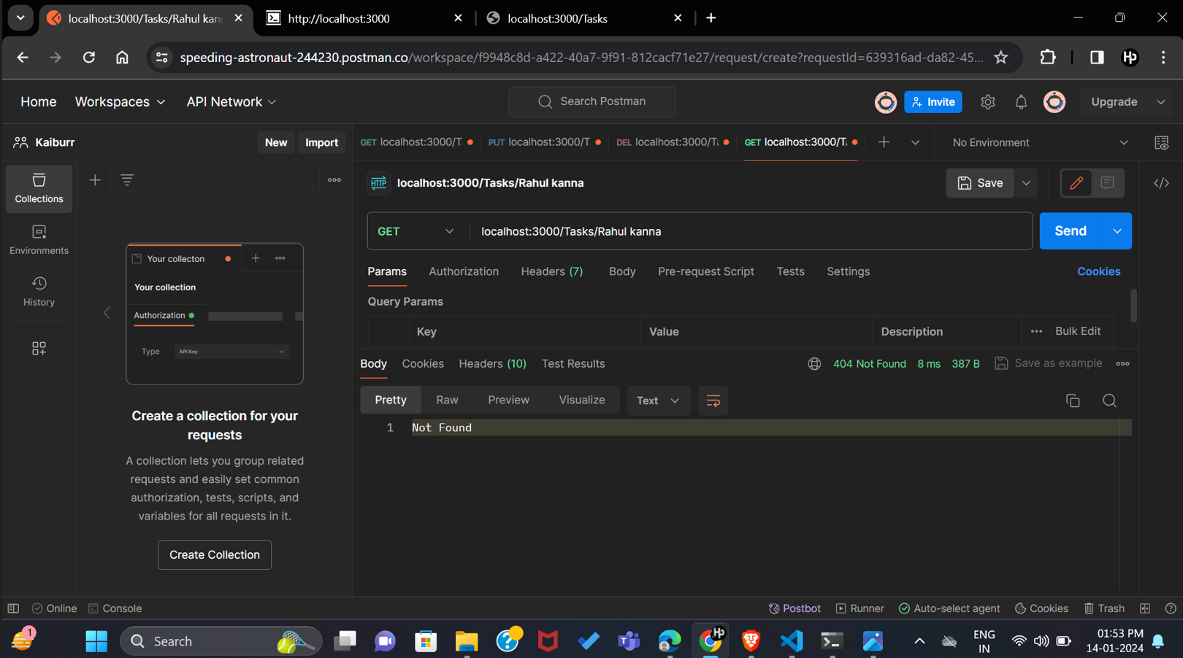
Hariprannav D

Slide 15
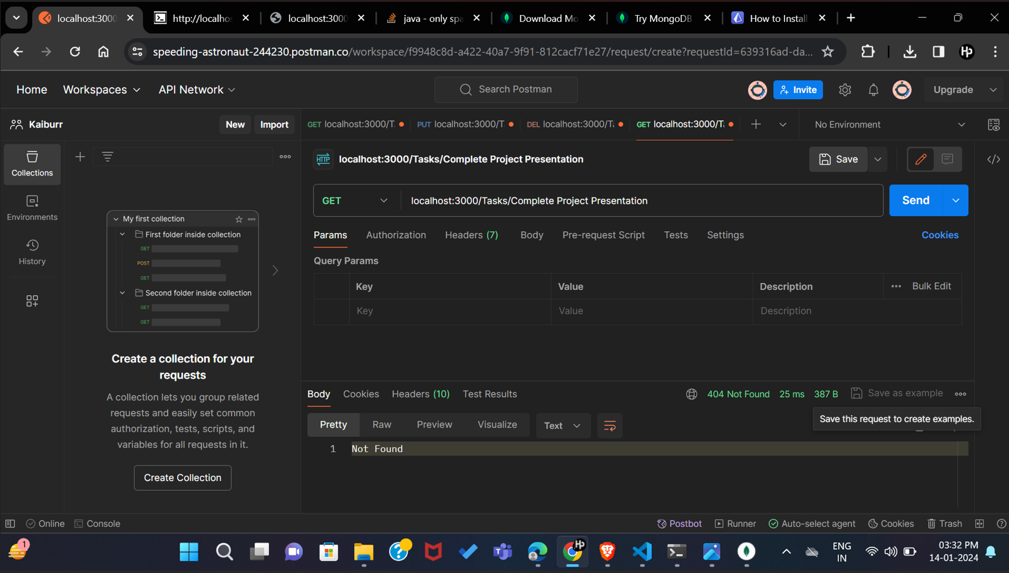
Hariprannav D

